Slide 1
Linux Administration

Slide 2
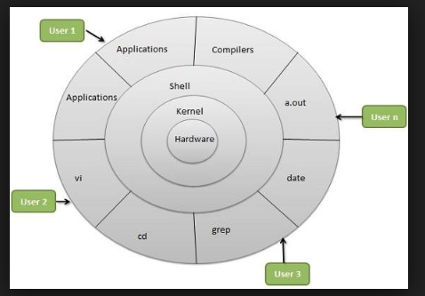
Index
Introduction to Linux
Why Linux
Linux Architecture
File system hierarchy
Linux Commands
Networking commands
Introduction to Linux:
Why Linux
Multiuser and multi-tasking
Open source
Security
Linux Architecture

Slide 3
File System Hierarchy
/ → This is top level directory.
/root → It is home directory for root user.
/home →It is home directory for other users.
/boot → It contains bootable files for linux.
/etc → It contains all configuration files.
/usr→ By default software installed in this directory.
/bin → It contains commands used by all users
/sbin→It contains commands used by super user.
/dev →dev directory contains the special device files for all the devices.
/lib →The lib folder is a library files directory which contains all helpful library files usedby the system.
/opt →According to the Filesystem Hierarchy Standard, /optis for “the installation of add-on application software packages”.
/tmp→ Web browsers periodically write data to the tmp directory during page views and downloads.
/var → Contains variable data like system logging files

Slide 4
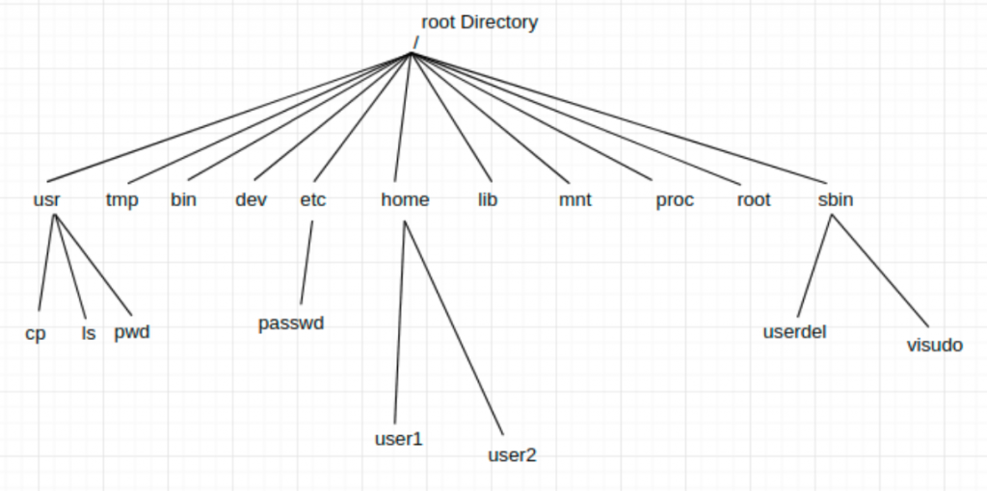

Slide 5
Basic Commands:
su
sudo
whoami
cd
pwd
ls -latr
touch
cat
vi
mkdir
cp
mv
rmdir
rm
grep
Less
Head
tail
Sort
Clear
tree

Slide 6
History
Wget
Tar
Rpm
Yum
User
Group
History
Du
Df
Free
Uptime
Wc
os-release
Diff
Find
Systemctl
Tracerout
Ping
Ifconfig
Route
Hostname

Slide 7
Commands with examples:
1)sudo
-->sudo is an abbreviation of “super user do” and is a Linux command that allows programs to be executed as a super user (aka root user) or another user.
2)su
→The purpose of sudo command is used to execute the commands with root privileges.
→su is used to switch from one user to another
→If no user name is specified for su, then it switches to root.
[]su
3)whoami
-->whoami command dislays the currently logged-in user.
[]whoami
4)cd
→cd command is used to change the current working directory
→# indicates you are the root user
→$ indicates you are the normal user
[] cd
[] cd /etc
→In you want to get back to one step
[] cd ..
→If you want to get back two steps
[]cd ../..

Slide 8
5)pwd
[]pwd
→pwd stands for present working directory.
→It will show you currently you are in which directory
6)ls -latr
→to view all the list of files and directories we can use ls -latr
[] ls -latr
7)Touch
→With touch we can create empty files
[] touch filename
[]touch pavani
→With touch we can create multiple files at a time
[] touch pavani1 pavani2 pavani3
8)cat
→by using cat we create the files with data
[] cat > file1
→insert some data
→to save the data ctrl+d
→to check the data
[] cat filename

Slide 9
9)vi
→By using vi editor or vim editor we can create files with data
[]vi filename
[]vi pavani1
→press i to insert the data
→to save the data :wq!
→to quit the saving data :q!
10)mkdir
→By using mkdir we can create directories
[]mkdirdirectoryname
[]mkdir pavani
11)cp
→cp stands for copy
→copy command used to copy the data from one file to another
[]cp file1 file2
file1=source
file2=destination
12)mv
→move command used to move the data from one file to another
[]mv file1 file2
file1=source
file2=destination

Slide 10
13)rmdir
→rmdir used to remove the empty directory
[]rmdir directoryname
14)rm
-->rm is used to remove the files and directories with data.
[]rm -rf filename(or)directoryname
15)grep
→The grep command is a filter that is used to search for lines matching a specified pattern and print the matching lines to standard output.
[]ls -latr |grep pavani
16)less
→Less command is linux utility which can be used to read contents of text file one page(one screen) per time. It has faster access because if file is large, it don't access complete file, but access it page by page.
[]less cat /etc/passwd
17)head
→The head command, as the name implies, print the top N number of data of the given input. By default, it prints the first 10 lines of the specified files.
[]head /etc/passwd
→By default it will display top 10 lines
[]head -3 /etc/passwd

Slide 11
18)tail
→By default tail returns the last ten lines of each file that it is given.
[]tail /etc/passwd
[]tail -3 /etc/passwd
19)sort
→sort command sorts the contents of a text file, line by line.
[]sort filename
20)clear
→It is used to clear the terminal screen.
[]clear
21)tree
→Purpose: Displays directory paths and (optionally) files in each subdirectory. When you use the TREE command each directory name is displayed along with the names of any subdirectories within it.
[] tree
[]yum -y install tree
22)history
→It will show you the history of commands you have used
23)wget
→wget is used to download the pacakges from web
[]wget urlname
[]wget http://apachemirror.wuchna.com/tomcat/tomcat-8/v8.5.54/bin/apache-tomcat-8.5.54.tar.gz

Slide 12
24)tar
-->The Linux ‘tar’ stands for tape archive, is used to create Archive and extract the Archive files
[]tar -xvzf filename.tar.gz
x- extract the archive
v-Verbose, displaying information about the archive while archiving
z-Using gzip compresession
f-Using an archive file
25)rpm
--> RPM command is used for installing, uninstalling, upgrading, querying, listing, and checking RPM packages on your Linux system. RPM stands for Red Hat Package Manager. With root privilege, you can use the rpm command.
[]rpm ivh MySQL-client-3.23.57-1.i386.rpm
--> -i : install a package
-->-v : verbose
-->-h : print hash marks as the package archive is unpacked
26)yum
→yum command used to install the pacakages
[]yum -y install python
what is the diffeernec between rpm and yum?
--> The major differences between YUM and RPM are that yum knows how to resolve dependencies.

Slide 13
27)user
-->A person who uses the system to use services and resorces.
-->Creating user
[]useradd pavani
[]grep pavani /etc/passwwd
-->Assign password to user
[]passwd pavani
enter the password
[]grep pavani /etc/shadow
28)group
-->A collection of users is called group
-->Creating group:
[]groupadd devops
-->Assign password
[]gpasswd devops
-->Adding users to group
[]gpasswd -M pavani devops
(syntax: []gpasswd -M username groupname)
29)history
-->It will show you the history of commands you have used.
[]history

Slide 14
30)du
-->du stands for disk usage.
-->It is used to esrimate file space usage.
--> The du command can be used to track the files and directories which are consuming excessive amount of space on hard disk drive.
[]du -sh
31)df
--> display the summary of available and used disk space usage of file system
[]df -h
32)free
--> It shows used memory and unused memory size.
[]free -m
33)uptime
--> Uptime is a command that returns information about how long your system has been running.
[]uptime
34)How to check word count in a file
--> wc command allows you to count the number of lines, words, characters, and bytes of each given file
[]wc -c filename
35)How to find OS information
-->OS information can be found by below command
[]cat /etc/redhat-release

Slide 15
36)diff
--> diff is a command-line utility that allows you to compare two files line by line
[]diff file1 file2
37)find
--> Find command is used to search and locate the list of files and directories based on arguent you have provided.
[]find -name pavani.txt
38)systemctl
-->systemctl command used to check the status of a service
[]yum -y install httpd
[]systemctl status httpd
39)traceroute
-->traceroute is used to know the travelling path of package through our network.
-->It will tell us package is going through macines, switches,ruters.
-->It will also tells us network is working properly or not.
[]traceroute -n
[]traceroute google.com
40)ping
-->ping stands for packet internet groper
-->It basically checks for the network connectivity between two nodes
[]ping google.com

Slide 16
41)ifconfig
-->It is used to dispay the ipaddress of a machine.
[]ifconfig all
42)route
-->route command is used to display the routing tabel information
-->used to determine where data packets traveling over an Internet Protocol (IP) network will be directed
[]route
43)hostname
-->Linux hostname is the simple command used to view and set the hostname of a system
[]hostname
[]sudo hostname <newname>

